Slide 1

Arfaoui Eya
Ben Attia Isra
Lassoued Malek
Labidi Mohamed Aziz
Financial Markets
Project Work :
Portfolio Optimization strategy
2024-2025
Tunis Business School

Slide 2

Financial Markets Project Objective :
The project aims to construct and analyze a diversified portfolio of 10 stocks on the Tunis Stock Exchange over three months. It involves applying technical and fundamental analysis, optimizing the portfolio using the Markowitz Model, and estimating returns with CAPM. Performance will be evaluated using metrics like Sharpe Ratio, and results benchmarked against indices. The goal is to achieve optimal performance within practical and theoretical constraints.

Slide 3
Brokers Contacted:
Attijari Intermédiation: 4 basis points (after negotiations)
Tunisie Valeurs: 6 basis points (after negotiations)
BNA Capitaux: 7 basis points (after negotiations)
MAC SA: 2 basis points
Amen Invest, BH Invest, STB Finance: Not contacted after choosing MAC SA.

Slide 4
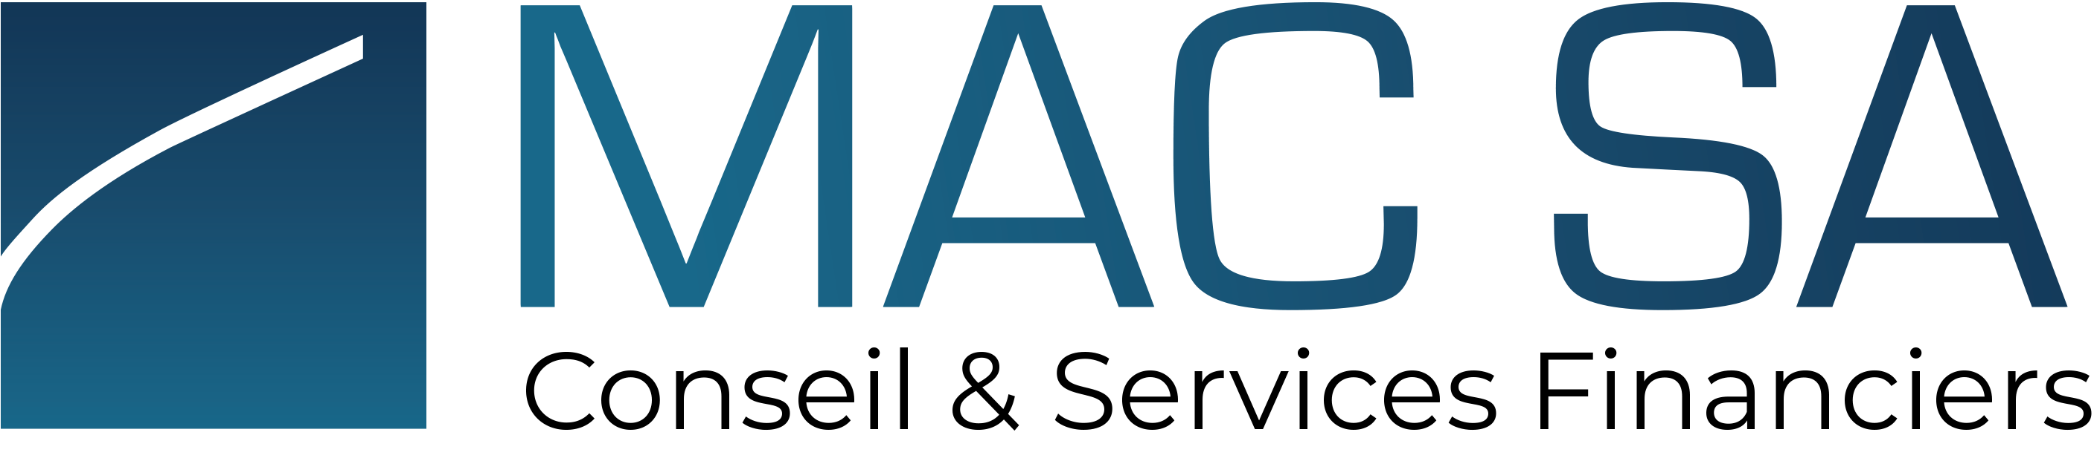
Brokerage choice:
We contacted four brokerage firms to negotiate fees and services. After thorough discussions, MAC SA was selected as our partner due to its offer of the lowest fees at 2 basis points and its strong reputation for ethical and transparent practices. MAC SA's alignment with our values ensured both cost efficiency and reliability.

Slide 5
Stock Selection Strategy :
For our stock selection strategy, we adopted the diamond model, which integrates both top-down and bottom-up approaches to achieve a comprehensive analysis. The top-down approach allowed us to identify promising sectors based on macroeconomic indicators and market trends, while the bottom-up approach enabled a detailed evaluation of individual companies based on financial health, growth potential, and valuation metrics. This combined method ensures a balanced and strategic selection of stocks, enhancing the overall portfolio's performance and risk management.

Slide 6
The Top down approach :
We analyzed Tunisia’s broader economic environment, focusing on key macroeconomic factors such as interest rates, inflation, and GDP growth. Higher interest rates benefit sectors like Financial Services, while inflation impacts consumer staples and industrials, which remain resilient. Economic growth tends to boost cyclical sectors such as consumer discretionary and automobiles during recovery phases. By examining sector performance indicators like net income growth, revenue trends, and dividend yields, we identified Food & Consumer Goods, Beverages, and Financial Services as top-performing sectors.
From this, we identified the top-performing sectors and shortlisted 27 publicly listed companies, including some direct competitors, for further analysis.

Slide 7
The Bottom-Up Approach :
In this approach, we conducted both fundamental and risk analyses to select 20 stocks from a pool of 27. Fundamental Analysis: We applied key criteria including EPS, ROE, revenue growth rate (delta revenue), debt ratio, D/E ratio, and P/E ratio to assess the financial health and performance potential of each stock. Risk Analysis: We utilized beta and the Sharpe ratio to evaluate the risk-adjusted returns of the stocks, ensuring a balance between risk and expected return. These criteria helped us select 20 stocks that align with our project objective.

Slide 8
Statistical Analysis :
For this analysis, we used historical data over a 10-year period and calculated the daily returns for each stock. We then computed key statistical metrics, including: average return: to measure the mean performance of each stock. Standard deviation: to assess the risk and volatility of returns. Kurtosis: to analyze the distribution of returns, identifying the presence of outliers. Skewness: to evaluate the asymmetry of the return distribution. Var (value at risk): to estimate potential losses at a given confidence level. Sharpe ratio: to assess the risk-adjusted performance of each stock.

Slide 9
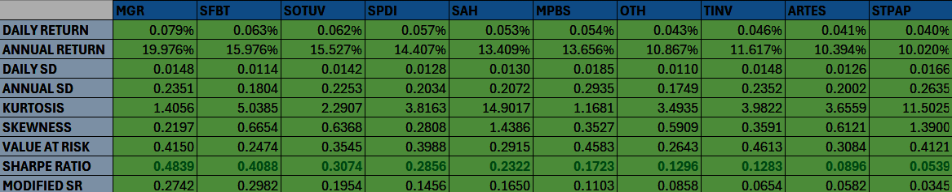
Final Stock Selection :
The final stock selection of 10 stocks was based on the Sharpe ratio, which helped evaluate the risk-adjusted returns of each stock. Stocks with higher Sharpe ratios indicate better performance relative to their risk, ensuring a balance between return and volatility. By focusing on these metrics, we identified 10 stocks with strong risk-adjusted returns, aligning with our investment objectives.

Slide 10
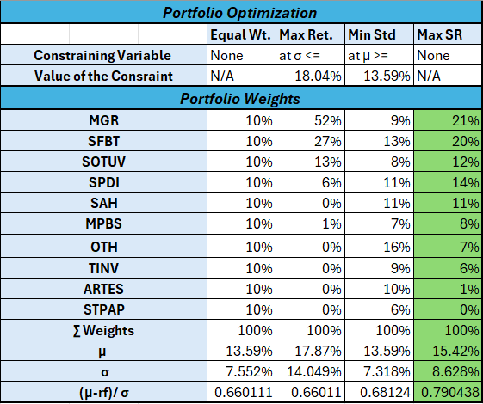
Portfolio Optimization :
In this step, we applied three approaches for portfolio optimization: Maximizing Return Minimizing Standard Deviation Maximizing the Sharpe Ratio (Markowitz Model) After evaluating these methods, we chose the Markowitz model, which focuses on optimizing the trade-off between risk and return. This model led to a portfolio of 9 stocks, as one of the 10 selected stocks had a weight of zero, ensuring an efficient allocation of assets.

Slide 11
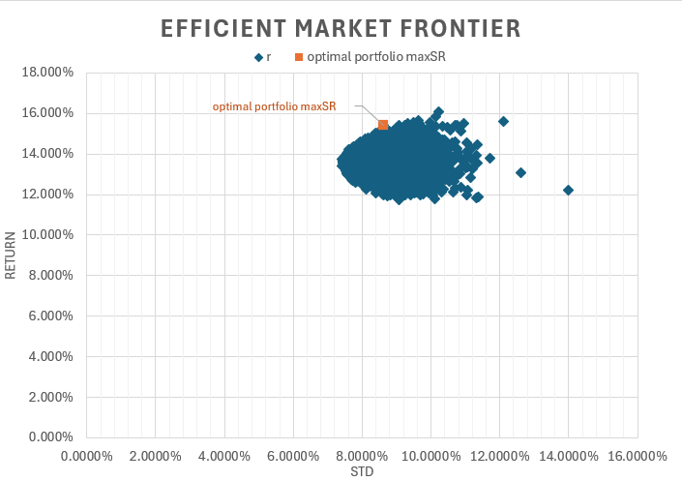
Efficient Market Frontier :
In this step, we focused on constructing the Efficient Market Frontier (EMF), which represents the set of portfolios offering the highest expected return for a given level of risk. By plotting various combinations of risk and return, we identified the optimal portfolio that balances risk and reward. Our selected optimal portfolio lies on the Efficient Market Frontier, reflecting the best trade-off between risk and return based on our analysis

Slide 12
From Analysis to Execution: Portfolio Insights
Technical Analysis :
Market Orders :
Portfolio Performance Analysis :
We conducted technical analysis for each of the 10 selected stocks using the RSI (Relative Strength Index) method. This involved studying the RSI trend for each stock to identify potential overbought or oversold conditions, as well as entry and exit points. The RSI analysis helped confirm the strength or weakness of each stock’s trend, providing additional insights for portfolio management
After conducting technical analysis using the RSI method and identifying the optimal entry points for each stock, we placed all orders as market orders. This ensured timely execution based on the confirmed trends, aligning with our earlier technical analysis findings and providing a seamless execution strategy.
We tracked the portfolio’s performance from December 13th to December 31st, during which we observed significant fluctuations between gains and losses. By the end of this period, the portfolio closed with a gain of 0.340 DT, highlighting its overall positive performance despite the market volatility.

Slide 13
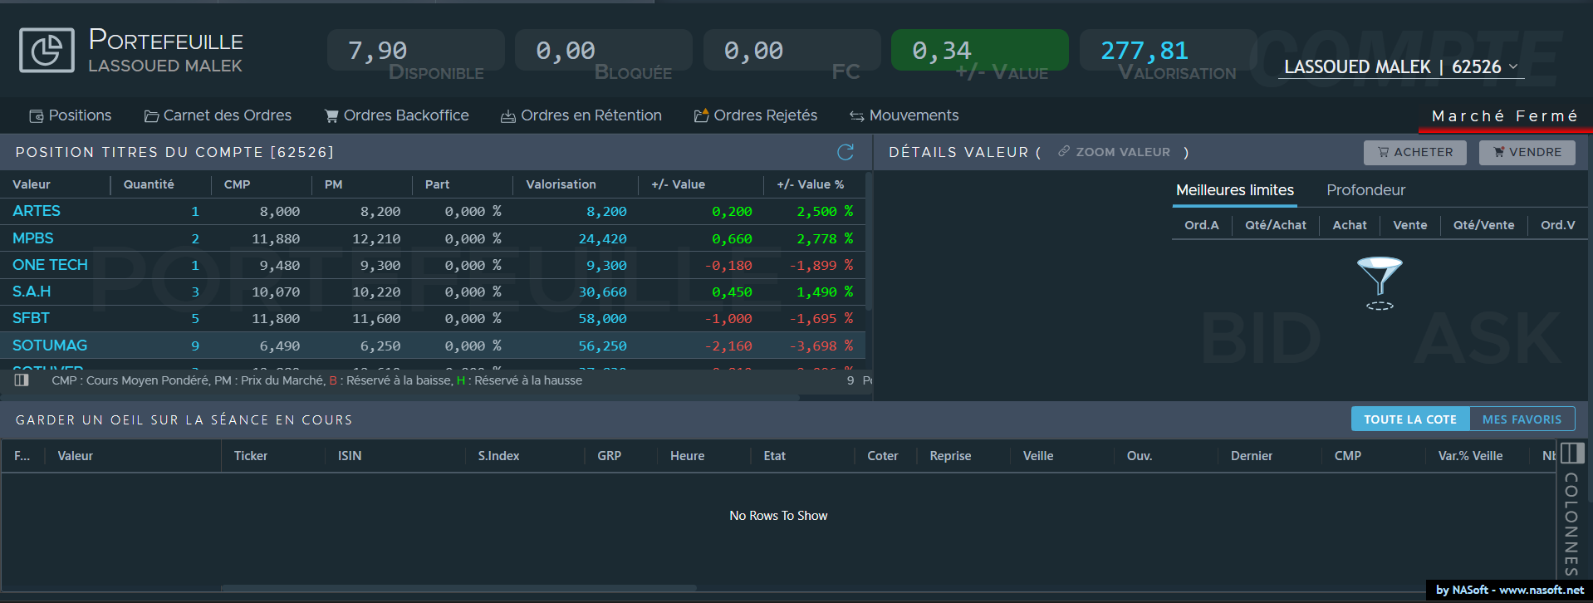
Portfolio state at the 31st of December

Slide 14
Rebalancing :
Rebalancing was not performed due to the short investment period from December 13th to December 31st . Given the limited timeframe, rebalancing would have incurred unnecessary transaction costs without significantly impacting the portfolio’s performance. This decision aligned with our strategy to minimize expenses during a short-term investment horizon.

Slide 15
Time-Weighted vs. Money-Weighted Analysis :
The time-weighted return measures the portfolio's performance independent of cash flows, focusing solely on the returns generated by the investments over time. It is ideal for evaluating the manager's investment decisions. In contrast, the money-weighted return accounts for the timing and size of cash flows, reflecting the actual investor's experience. This metric emphasizes how contributions and withdrawals impact overall portfolio performance. Both methods provide complementary insights into the portfolio’s returns.

Slide 16
Portfolio Performance and Risk Analysis :
Key Performance Indicators :
Key Risk Indicators :
We analyzed the portfolio’s performance using key metrics, including:
Daily Return of the Portfolio
Portfolio Value
Investment Amount
Graphs of these indicators were plotted to visualize trends and assess the portfolio’s overall performance.
We evaluated the portfolio's risk using the following indicators:
Sharpe Ratio: To measure risk-adjusted returns.
Sortino Ratio: To focus on downside risk.
Beta: To assess the portfolio's market sensitivity.
These metrics provided a comprehensive view of the portfolio’s risk profile.

Slide 17
Conclusion & Performance Evaluation :
The portfolio achieved a small positive return, but risk-adjusted metrics like the Sharpe and Sortino ratios were negative, indicating suboptimal returns relative to the risk taken. To enhance future performance, adjustments in sector allocation or stock selection strategies will be essential.

Slide 18
THANK YOU

